Slide 1
Sequential Circuits
By J.J.N.D Harshitha
Kasura Technologies Private Limited

Slide 2
contents
Introduction
Classification of sequential circuits

Slide 3
Introduction
A Sequential circuit combinational logic circuit that consists of inputs variable , logic gates (Computational circuit), and output variable. Sequential circuit produces an output based on current input and previous input variables. That means sequential circuits include memory elements which are capable of storing binary information. That binary information defines the state of the sequential circuit at that time. A latch capable of storing one bit of information.

Slide 4
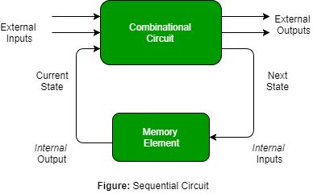
Block Diagram

Slide 5
Types of sequential circuits
The sequential circuits are classified in to the two types . They are –
Synchronous sequential circuits
Asynchronous sequential circuits

Slide 6
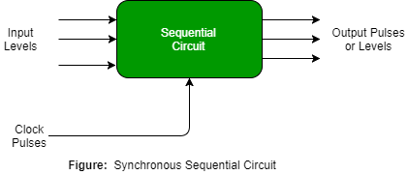
Synchronous sequential circuit
These circuit uses clock signal and level inputs (or pulsed) (with restrictions on pulse width and circuit propagation). The output pulse is the same duration as the clock pulse for the clocked sequential circuits. Since they wait for the next clock pulse to arrive to perform the next operation, so these circuits are bit slower compared to asynchronous. Level output changes state at the start of an input pulse and remains in that until the next input or clock pulse.

Slide 7
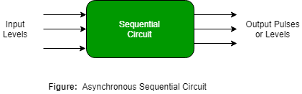
Asynchronous sequential circuit
These circuit do not use a clock signal but uses the pulses of the inputs. These circuits are faster than synchronous sequential circuits because there is clock pulse and change their state immediately when there is a change in the input signal. We use asynchronous sequential circuits when speed of operation is important and independent of internal clock pulse.

Slide 8
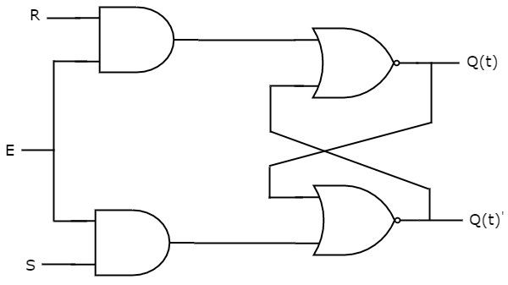
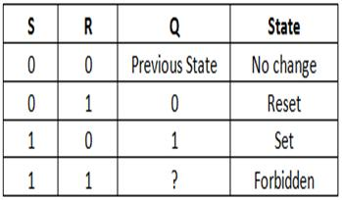
SR Latch
An SR latch (Set/Reset) is an asynchronous device: it works independently of control signals and relies only on the state of the S and R inputs. In the image we can see that an SR latch can be created with two NOR gates that have a cross-feedback loop. SR latches can also be made from NAND gates, but the inputs are swapped and negated. In this case, it is sometimes called an SR latch.

Slide 9
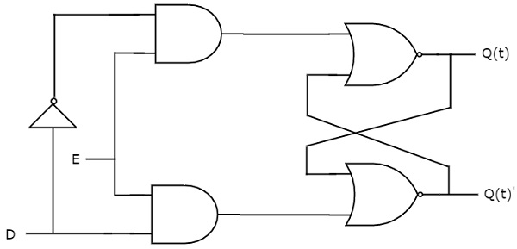
D Latch
The D latch (D for "data") or transparent latch is a simple extension of the gated SR latch that removes the possibility of invalid input states.
Since the gated SR latch allows us to latch the output without using the S or R inputs, we can remove one of the inputs by driving both the Set and Reset inputs with a complementary driver: we remove one input and automatically make it the inverse of the remaining input.
D | Q(t+1)
0 | 0
1 | 1

Slide 10
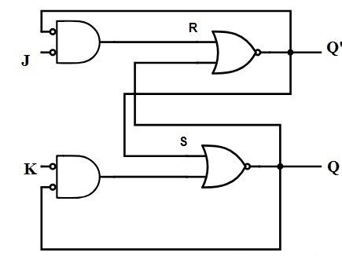
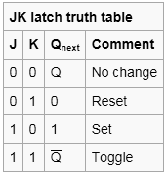
JK Latch
The both JK latch, as well as RS latch, is similar. This latch comprises two inputs namely J and K which are shown in the following logic gate diagram. In this type of latch, the unclear state has been removed here. When the JK latch inputs are high, the output will be toggled. The only difference we can observe here is the output feedback toward inputs, which is not present in the RS-latch.

Slide 11
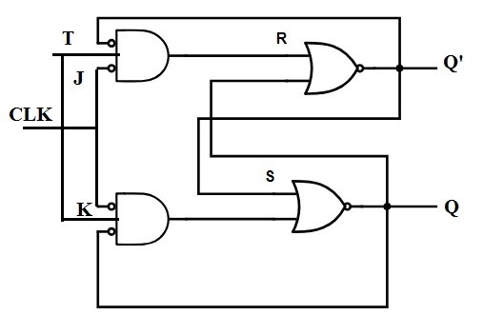
T Latch
The T latch can be formed whenever the JK latch inputs are shorted. The function of T Latch will be like this when the input of the latch is high, and then the output will be toggled.
T | Q(t+1)
0 | Q(n)
1 | Q(n) toggle

Slide 12
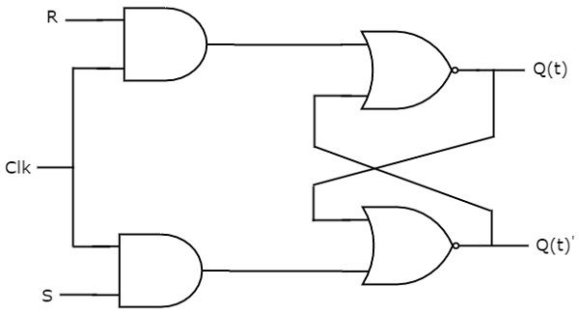
SR Flip-Flop
This SR flip-flop consists of two AND gates and a basic NOR flip-flop. The outputs of the two AND gates remain at 0 as long as the clock pulse is 0, irrespective of the input values of S & R. When the clock pulse is 1, information from the inputs S & R passes through to the basic flip-flop. When S=R=1, the occurrence of a clock pulse causes both the outputs go to 0. When the clock pulse is removed, the state of the flip-flop is unstated.
S | R | Qt+1
0 | 0 | Qt
0 | 1 | 0
1 | 0 | 1
1 | 1 | Forbidden

Slide 13
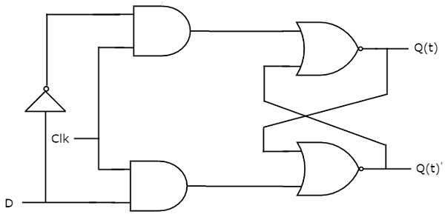
D Flip-Flop
The D flip-flop is the modification of the SR flip flop . The i/p D goes directly into the input S and the complement of the input D goes to the input R. The D input is sampled during the existence of a clock pulse. If it is 1, then the flip-flop is switched to the set state. If it is 0, then the flip-flop switches to the clear state.
D | Q(t + 1)
0 | 0
1 | 1

Slide 14
JK Flip-Flop
A JK flip flop is a modification of the SR flip flop. The inputs of the flip flop J, K behave like the inputs S and R. When input 1 is applied to both J & K, the flip flop switches to its complement state( if Q=1, it switches to Q=0). The JK flip flop figure is shown below.The output of the flip flop Q is ANDed with inputs k and clock pulse. The flip flop would be cleared during a clock pulse only if the output Q was previously 1. Likewise, the output Q’ is ANDed with inputs CP and J. So that the flip flop is set with a clock pulse only if Q’ was previously 1.

Slide 15
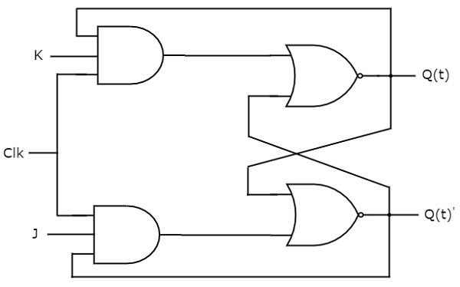
JK Flip-Flop
Present Inputs |  | Present State | Next State
J | K | Qt | Qt+1
0 | 0 | 0 | 0
0 | 0 | 1 | 1
0 | 1 | 0 | 0
0 | 1 | 1 | 0
1 | 0 | 0 | 1
1 | 0 | 1 | 1
1 | 1 | 0 | 1
1 | 1 | 1 | 0

Slide 16
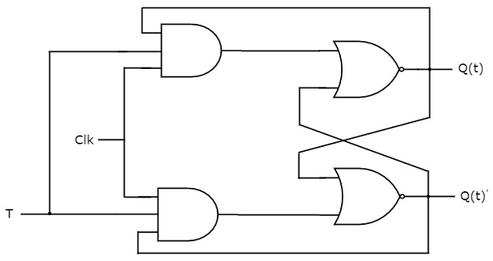
T Flip-Flop
The T flip flop is a single input version of the JK flip flop. The operation of this T flip flop is as follows: When the input of the T is ‘0’ such that the ‘T’ will make the next state the same as the present state (i.e. T = 0 then, present state = next state = 0). However, if the input of the T is ‘1’ then the ‘T’ will change the next state to the inverse of the present state (i.e. T = 1 present state = 0 and next state = 1).
Inputs | Present State | Next State
T | Q t | Q t+1
0 | 0 | 0
0 | 1 | 1
1 | 0 | 1
1 | 1 | 0

Slide 17
Applications
The communication between two elements, each hold its own independent clock, and this will be achieved by these circuits.
sequential circuits are implemented in the design of flip-flops, counters and to develop MOORE-MEALY state-controlled machines.

Slide 18


